Slide 1

Port Authority of New York and New Jersey ArcGIS as a System of Record
Esri | November 2017
Notes:
Before we get started I want to thank everyone for affording us your valuable time.

Slide 2

1. Construction Event Editor
Agenda at a Glance
2. Construction Events Operations Dashboard
3. Next Steps
Create a system of record to load and manage your construction events
Maintain situational awareness and metrics on key aspects of your operation
A system of record is only the first step
Notes:
Here’s agenda at a glance. We’ll be going over three broad items today:
An introduction to the ArcGIS API for Python
A demonstration of applying GIS and Machine Learning for a detection of CAFO sites.
A demonstration of spatial analysis for superfund site market potential.
I’d like to keep this flexible and open to discussion.

Slide 3
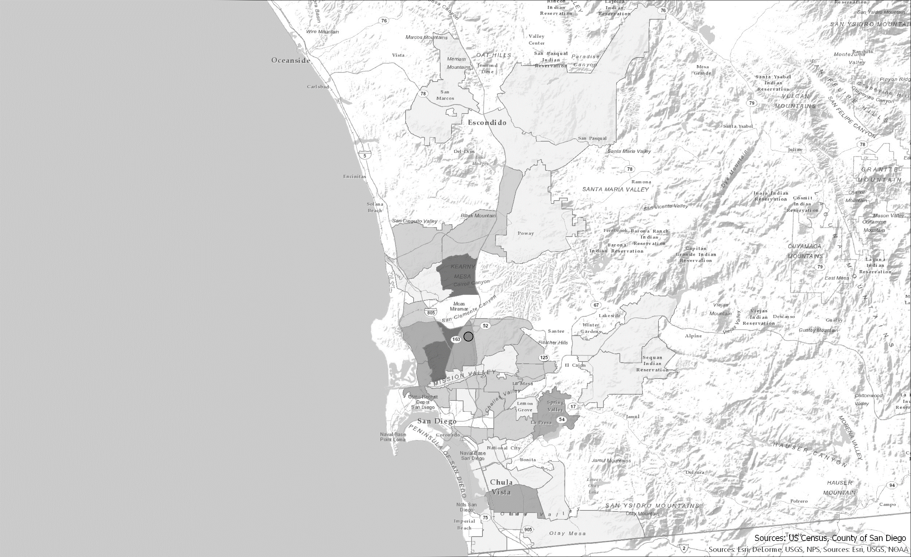
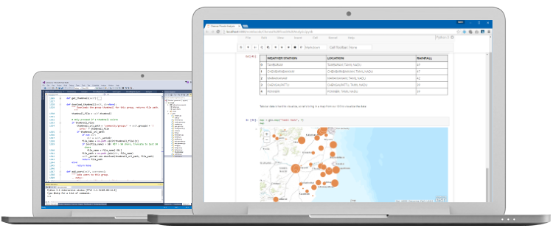
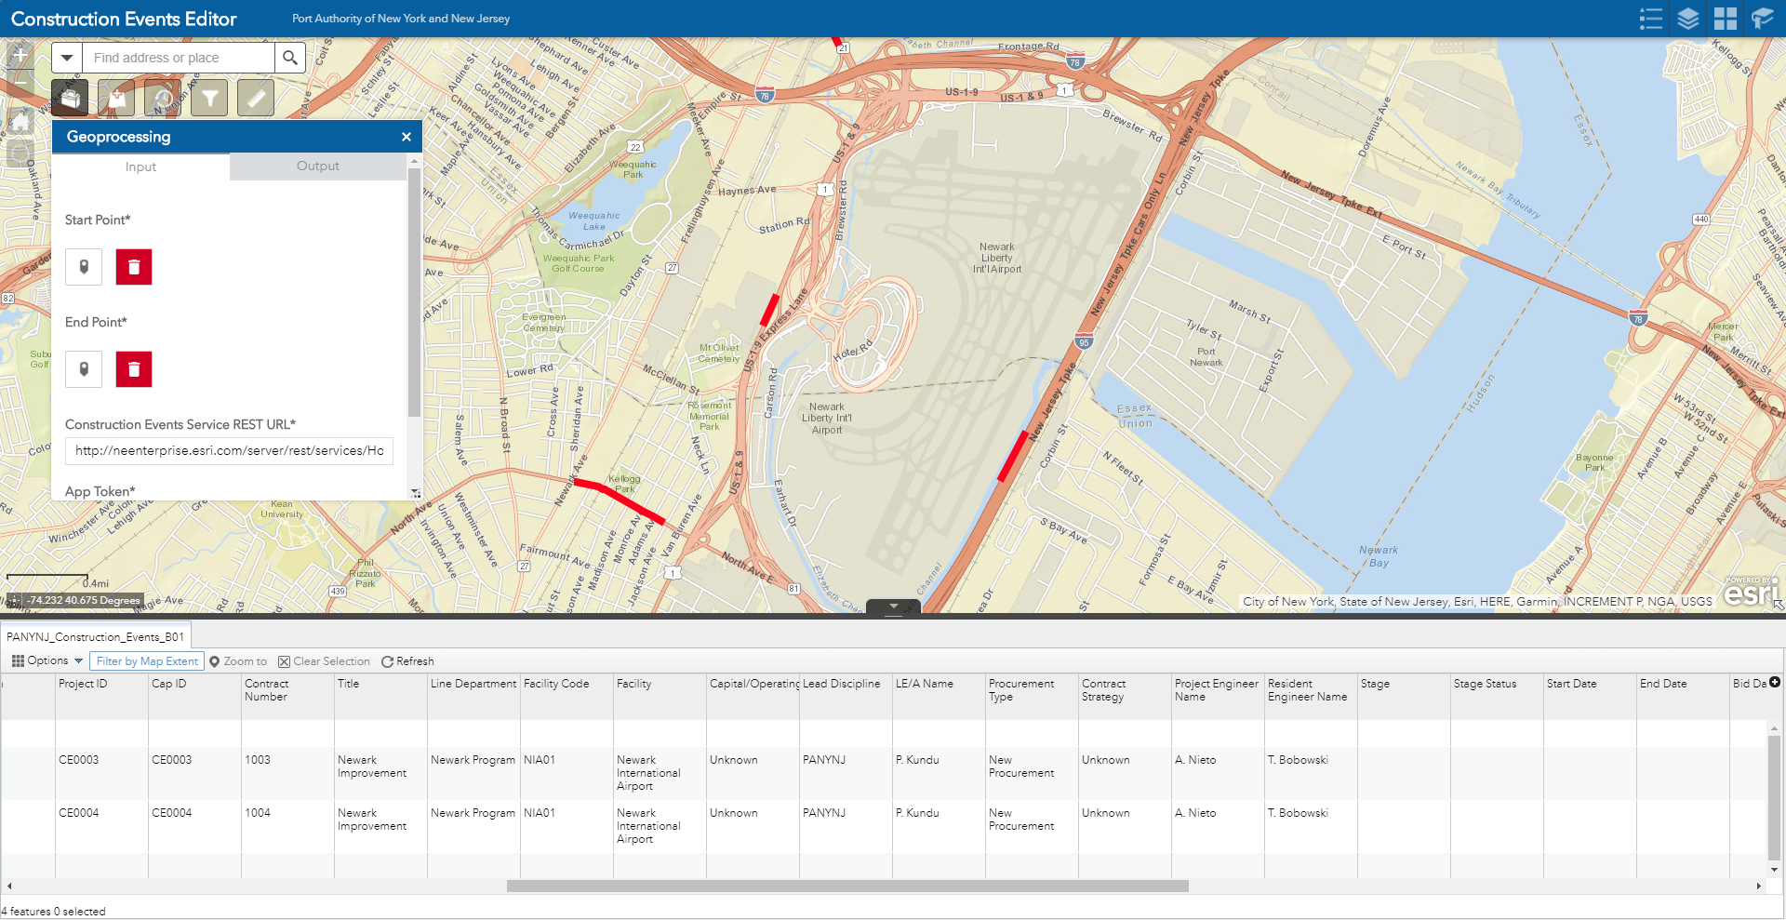
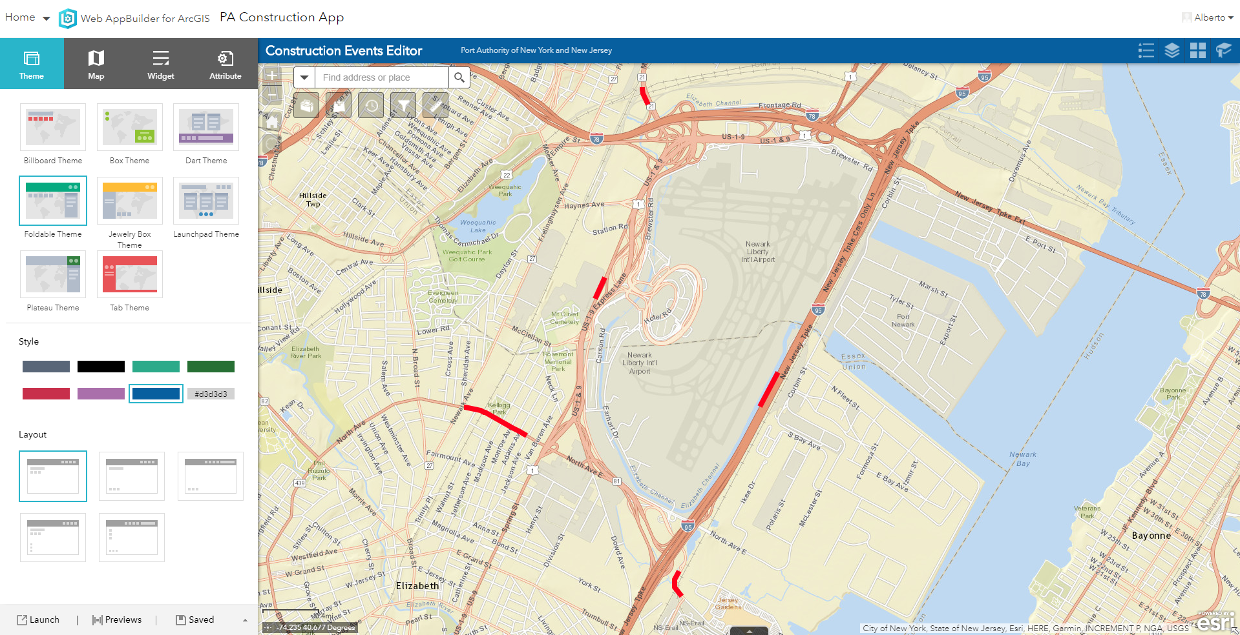
Construction Event Editor
Demo
Create a system of record to load and manage your construction events
Notes:
Without further ado, let’s get started.
One of the most exciting new capabilities in the ArcGIS platform is the ArcGIS API for Python.

Slide 4
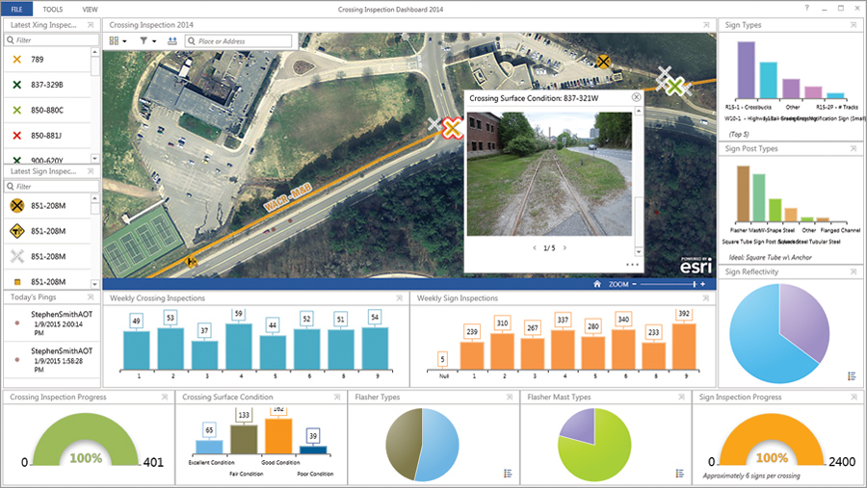
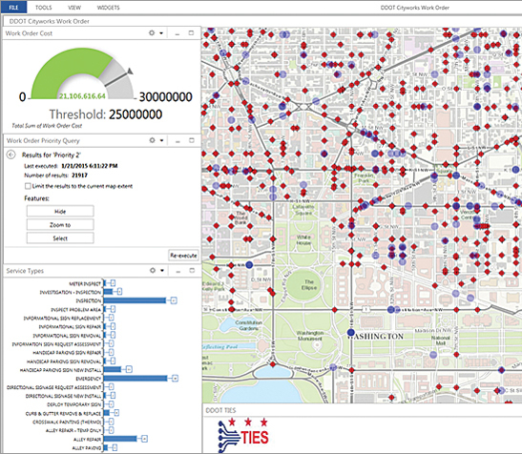
Construction Events Operations Dashboard
Demo
Maintain situational awareness and metrics on key aspects of your operation
Notes:
The next demonstration focuses on Concentrated Animal Feeding Operations, or CAFOs.
Coincidentally, I recently came across surprising facts about pigs, detailing how their intelligence surpasses that of dogs and even 3-year old humans. How they form social bonds and have great memories.
The vast majority of raised pigs in the United States never experience this life. 97% are born and raised in CAFOs where they are subject to grueling conditions.

Slide 5

Next Steps
Discussion
A system of record is only the first step

Slide 6

Possible Next Steps
Construction Event Impact Analysis
Time Slider and Time Fields
Field Collection and Inspection

